Slide 1
Agri Robot Mapping and Pathing
Toby WIlliam Towler

Slide 2
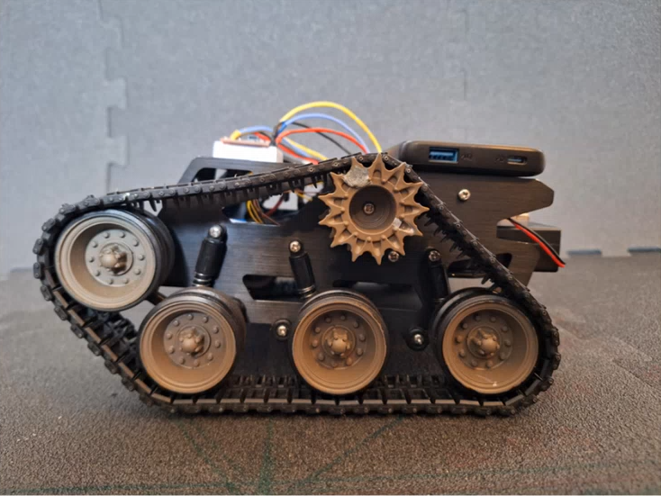
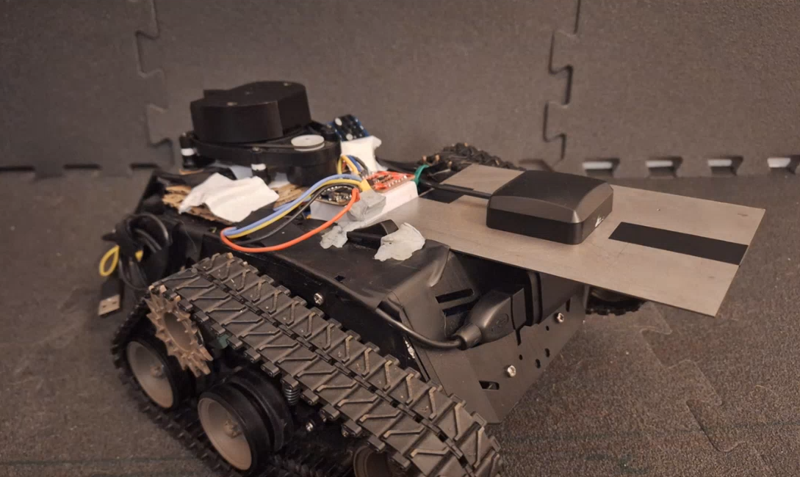
Introduction
Agri Robot
Developed by previous masters' students at UEA
Autonomous lawn mower
Repurpose Agri Robot for golf courses
Mapping
Route planning

Slide 3
Aims
Automate route planning
Map an area from an aerial image
Path planning with obstacle avoidance

Slide 4
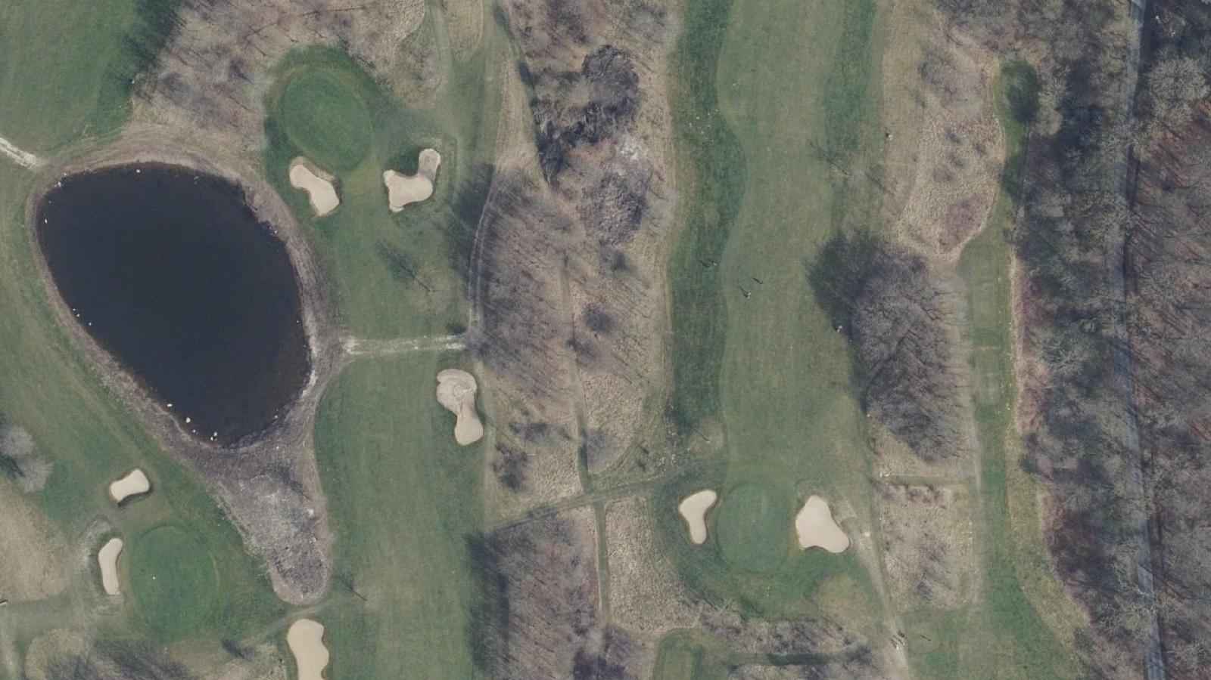
Mapping
From drone image/orthophoto - (uniform scaled image)
Neural network model
Golf course components
Bunker
Green
Fairway
Rough
Water

Slide 5
The model
MaskRCNN PyTorch
Mask Region-based Convolutional Neural Network
Designed for instance and semantic segmentation
Components are classes
Background, bunker, green, fairway, rough, water
Custom training data – Danish Golf Dataset
Custom annotations
Specialisation

Slide 6
Complete coverage path planning
Cover each point in an area at least once
Performance metrics
Shortest route
Fewest of turns
Obstacle avoidance

Slide 7
Complete Coverage Path Planning
3 groups
Green/Tee
Fairway
Rough
Levels – treat other as obstacles or not?
Cutting height and style
Shorter/longer
striped/textured

Slide 8
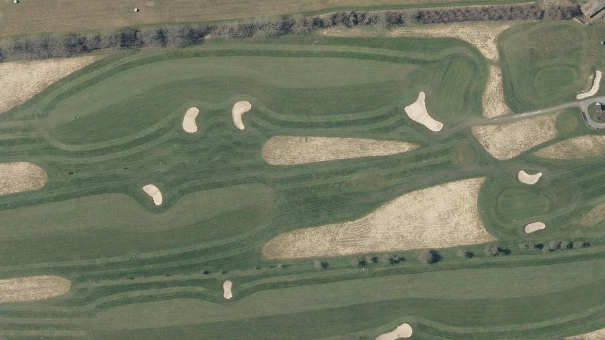
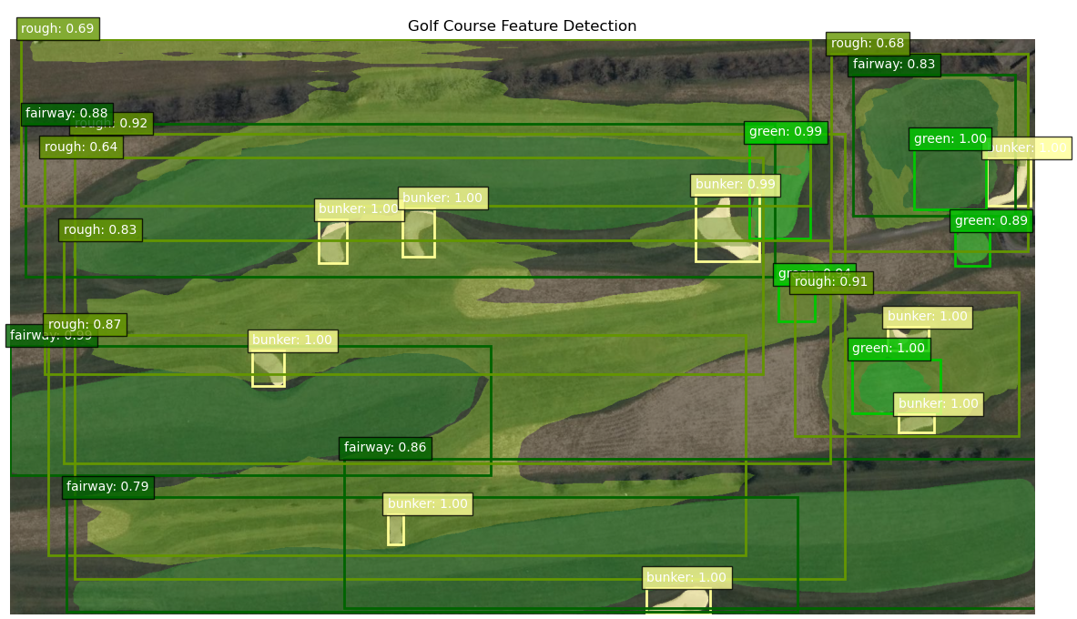
Outputs - model

Slide 9
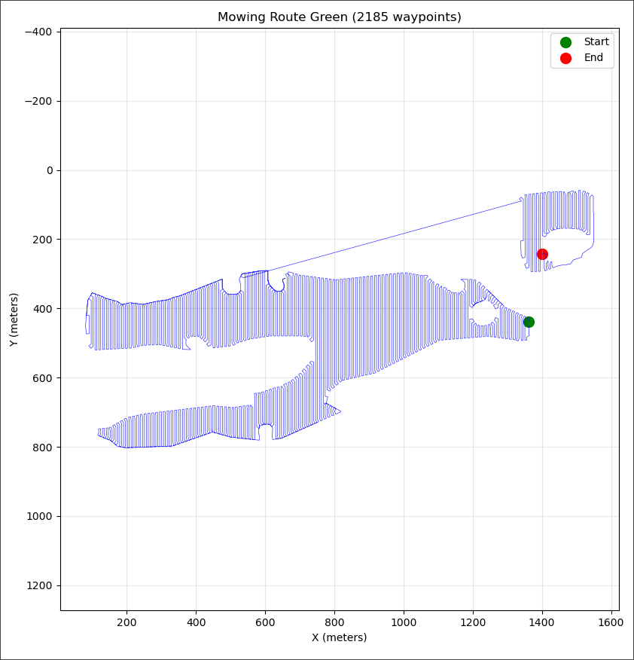
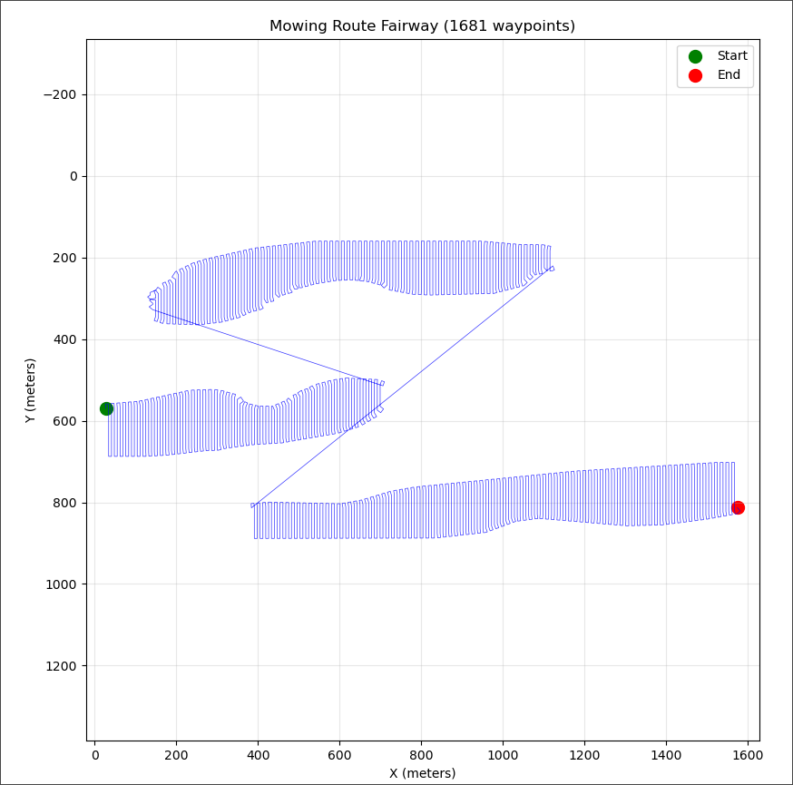
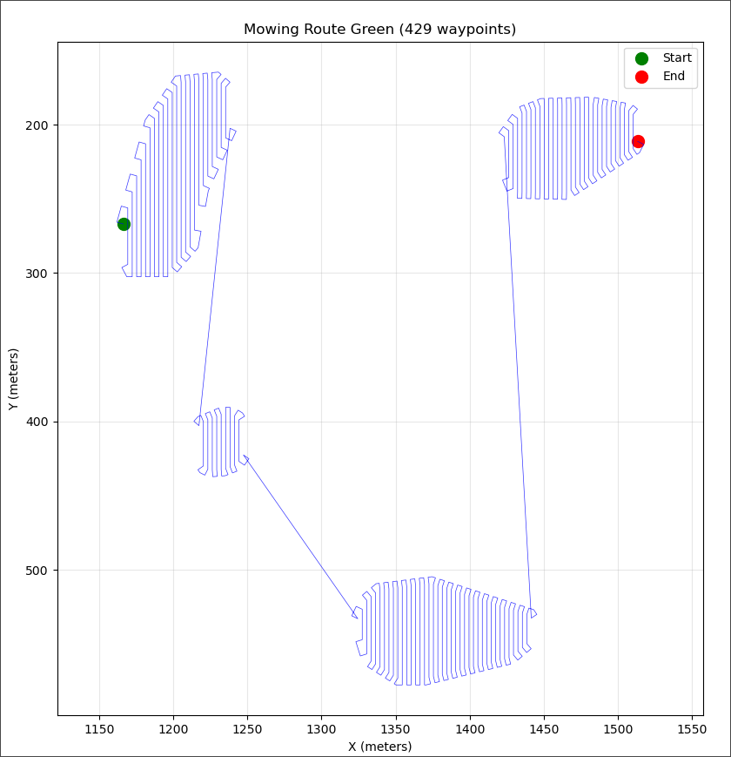
Outputs - paths

Slide 10
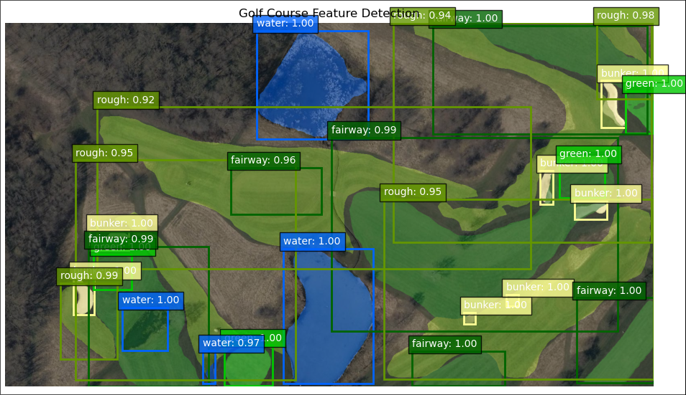
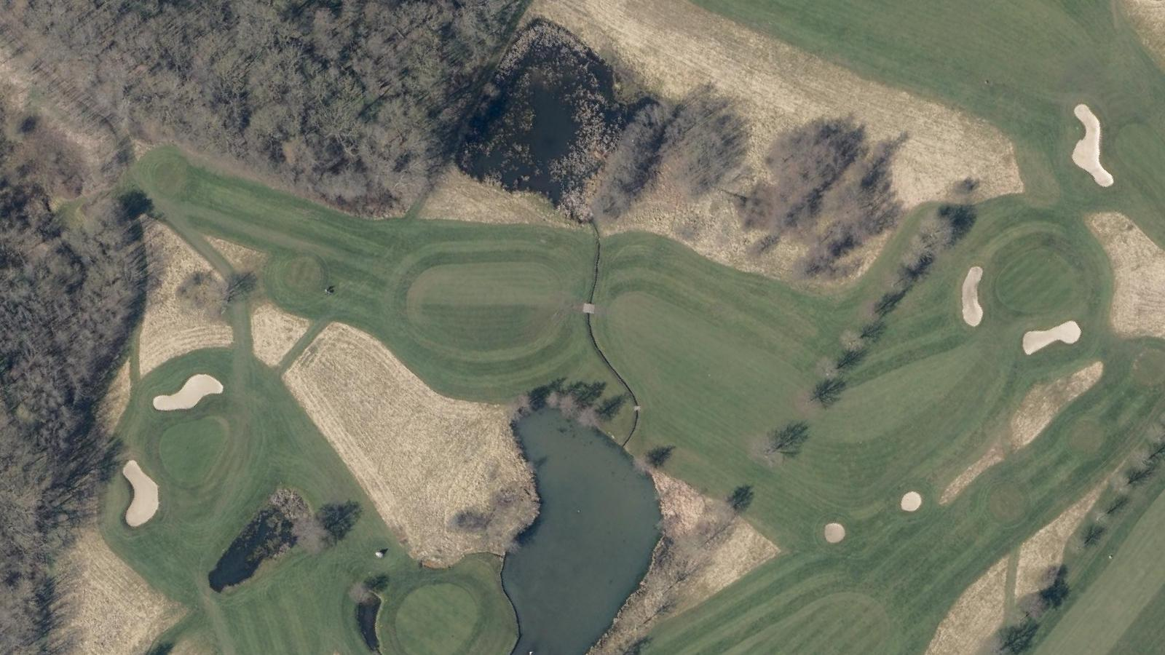
Outputs - model

Slide 11
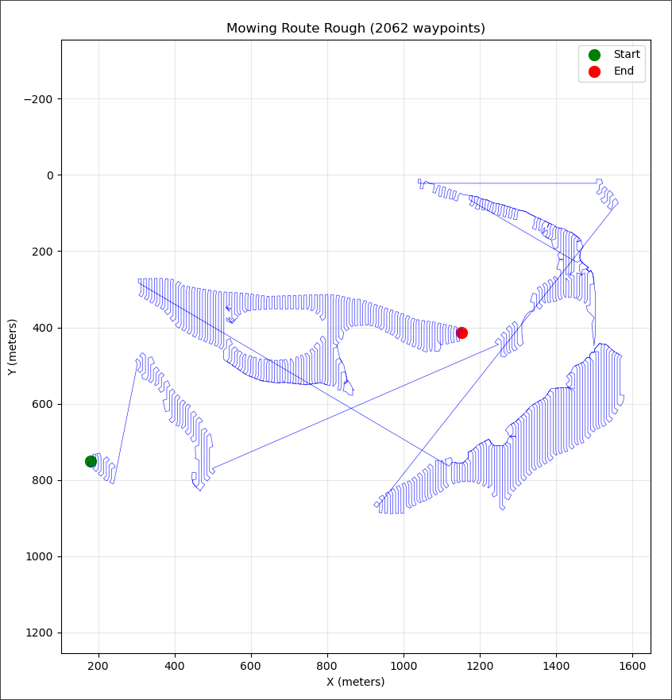
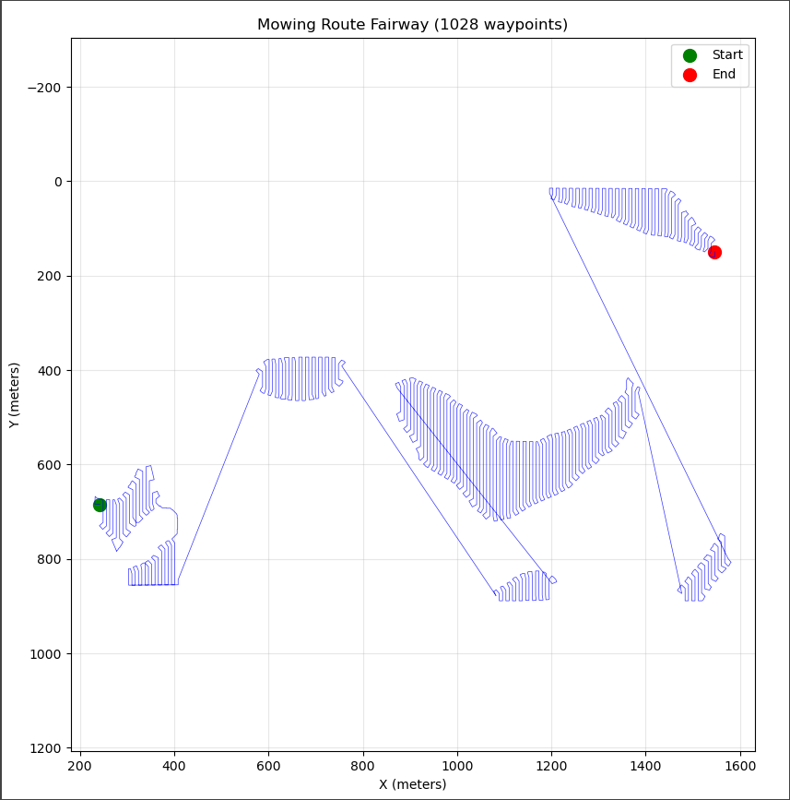
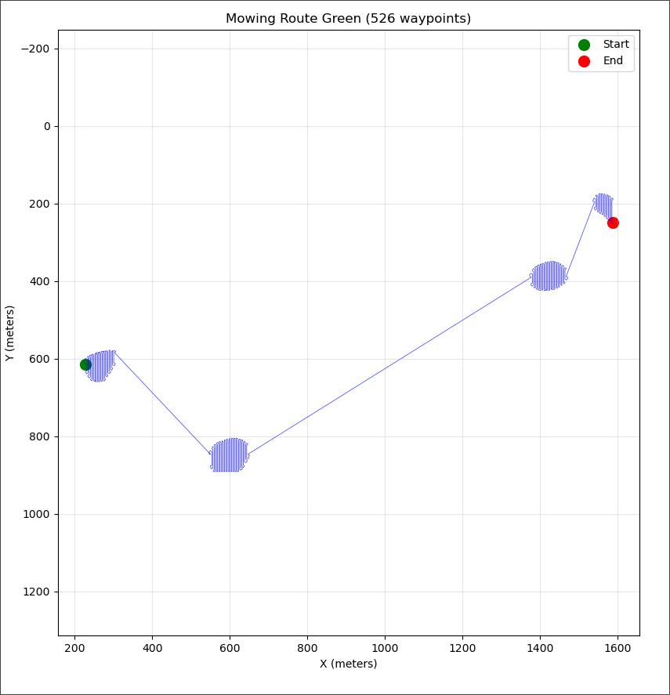
Outputs – paths 2

Slide 12
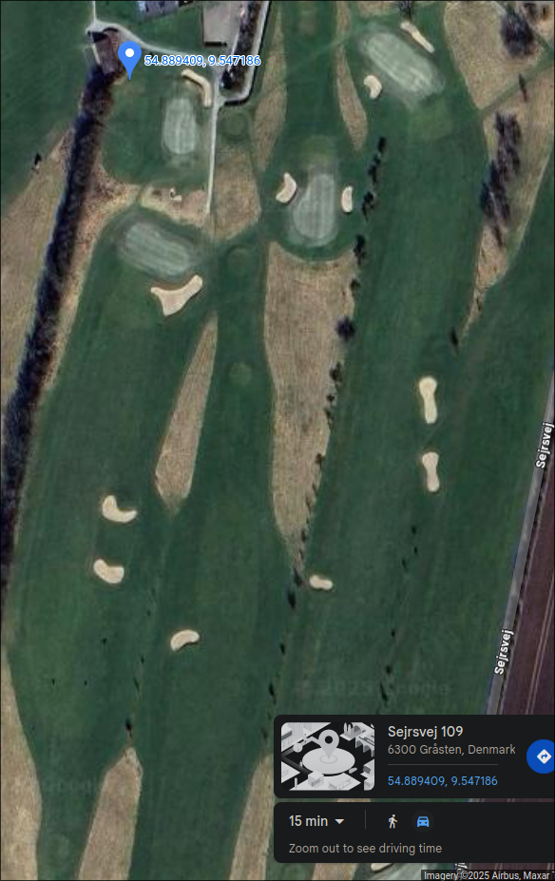
Real world transformation
GPS coordinates
Bearing
Size

Slide 13
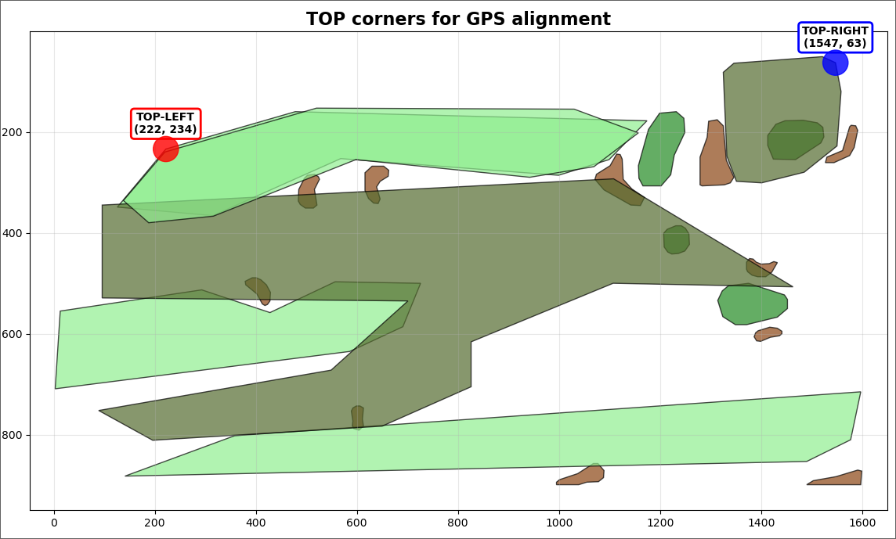
GPS

Slide 14
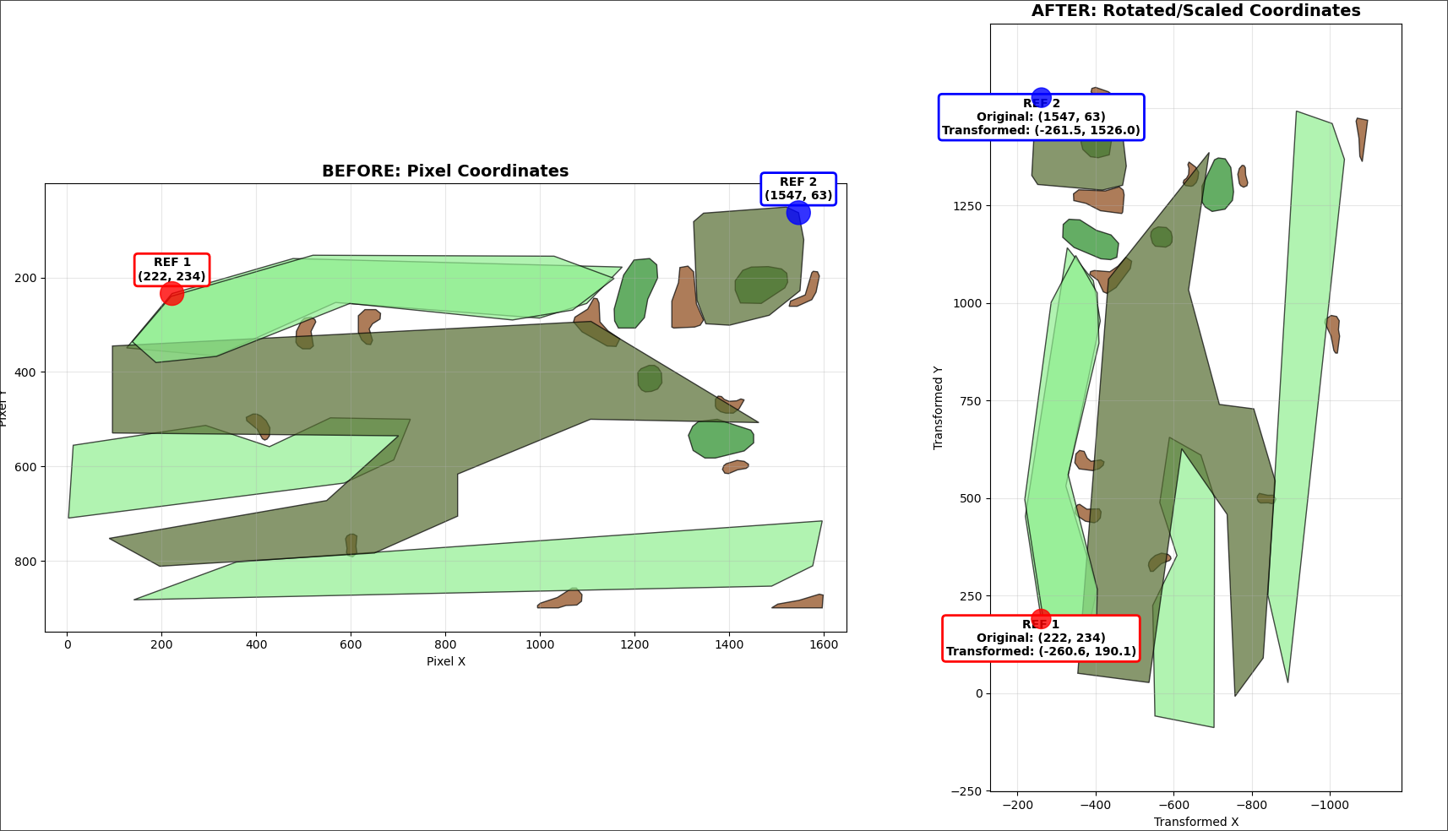
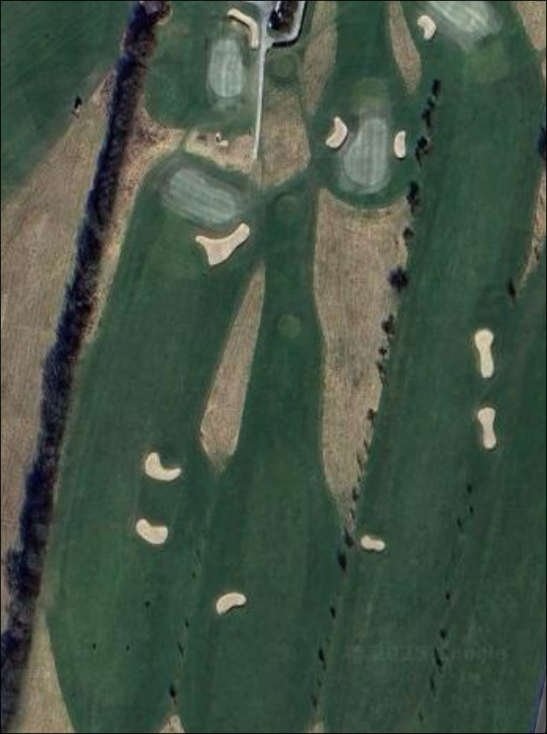
GPS

Slide 15
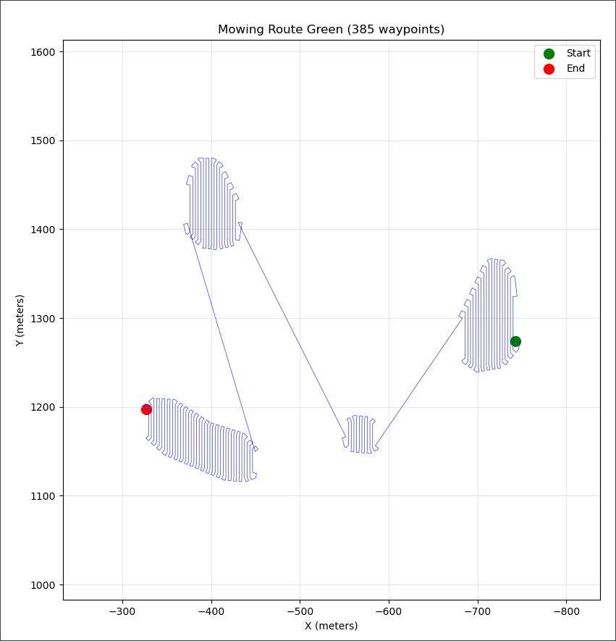
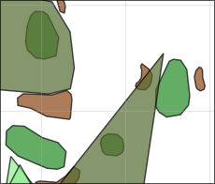
GPS paths

Slide 16

Demo

